Slide 1

XGBoost Regression Algorithm

Slide 2
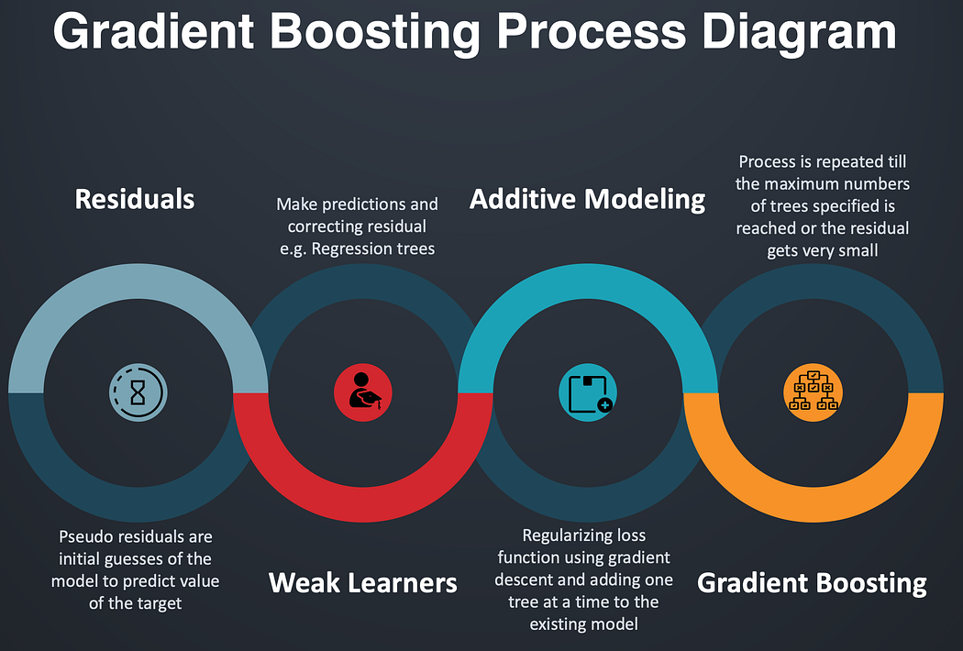
Introduction to XGBoost:
XGBoost (Extreme Gradient Boosting).
Key features: Speed, performance, and flexibility
High predictive accuracy
Handles missing values
Regularization to prevent overfitting
Key Concepts
Boosting: Combining weak learners to create a
strong learner
Decision Trees: Base learners in XGBoost
Gradient Descent: Optimization technique
used in XGBoost

Slide 3
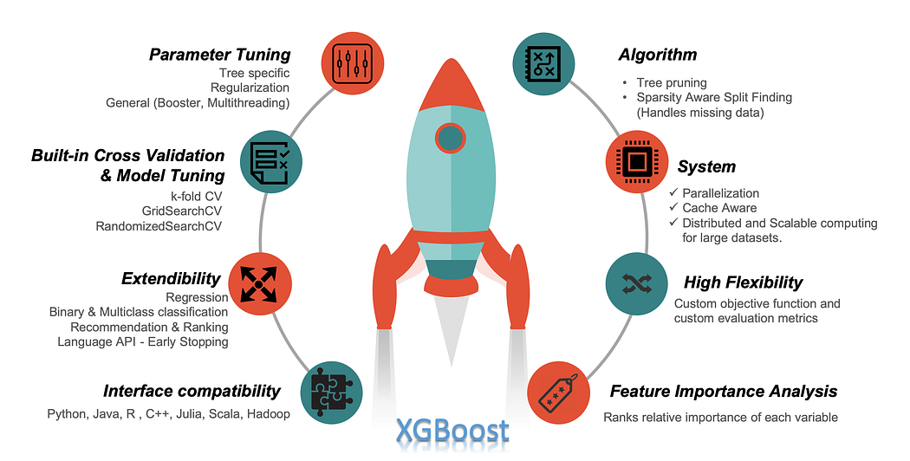
Step-by-step process:
Initialize predictions
Compute residuals
Fit decision trees to residuals
Update predictions
Repeat until convergence
Advantages of XGBoost
Speed and efficiency (parallel processing)
Flexibility (various objective functions)
Built-in cross-validation
Excellent performance on large datasets

Slide 4

Hyperparameters Tuning
Overview of key hyperparameters:
Learning rate
Number of trees
Max depth
Subsampling
Importance of tuning for optimal performance

